Slide 1
Pre-event Webinar & Workshop: July 2021 OGC API Virtual Code Sprint
July 14, 2021
#OGCAPI

Slide 2
Agenda
Welcome
Sponsor Remarks
User Needs and Use Cases
Overview of OGC API – Processes
Overview of OGC API – Records
Overview of OGC API – Coverages
Questions & Answers

Slide 5
Welcome
OGC invites you to the July 2021 OGC API Virtual Code Sprint, to be held virtually on:
Day 1: Wednesday 21 May from 07:00am to 05:30pm EDT.
Day 2: Thursday 22 May from 07:00am to 05:30pm EDT.
Day 3: Friday 23 May from 07:00am to 05:30pm EDT.
What is an OGC Code Sprint?
A collaborative and inclusive event driven by innovative and rapid programming with minimal process and organization constraints to support the development of new applications and open standards.

Slide 6
Motivation
APIs are a popular, effective method for rapid software development
There is an increasing need for interoperability between Web APIs
The growing uptake of location within and beyond geospatial developer communities

Slide 7
Overview of the draft specification
OGC API – Processes – Part 1: Core

Slide 8
Overview of the draft specification
OGC API – Records – Part 1: Core

Slide 9
Overview of the draft specification
OGC API – Coverages – Part 1: Core

Slide 10
Sprint Description
The scope of the code sprint is to include:
API implementation
API testing and feedback
Discussion and knowledge sharing
Participants are welcome to bring partial or complete implementations of servers or clients to support the sprint.
Participants will have the opportunity to experiment with parts of the specifications and develop working implementations.

Slide 11
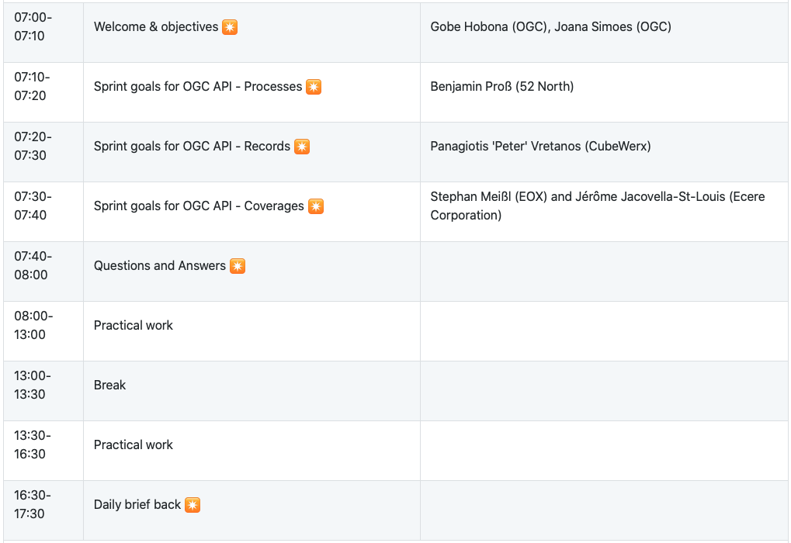
Sprint Schedule – Day 1 – July 21

Slide 12
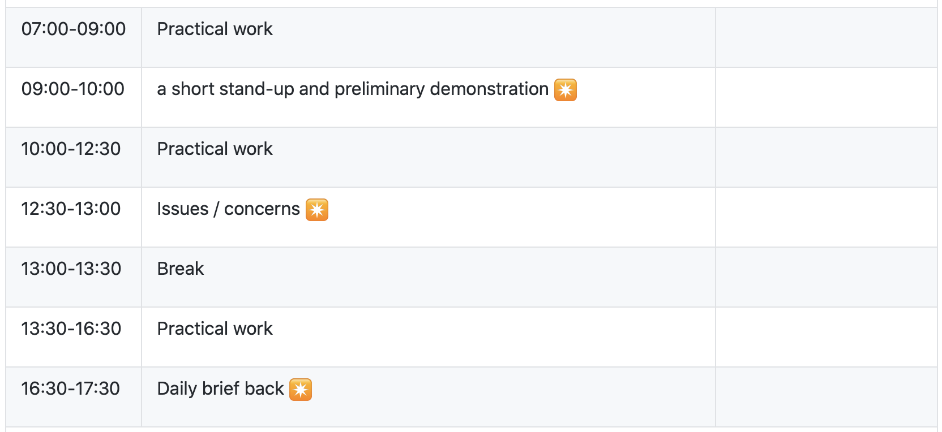
Sprint Schedule – Day 2 – July 22

Slide 13
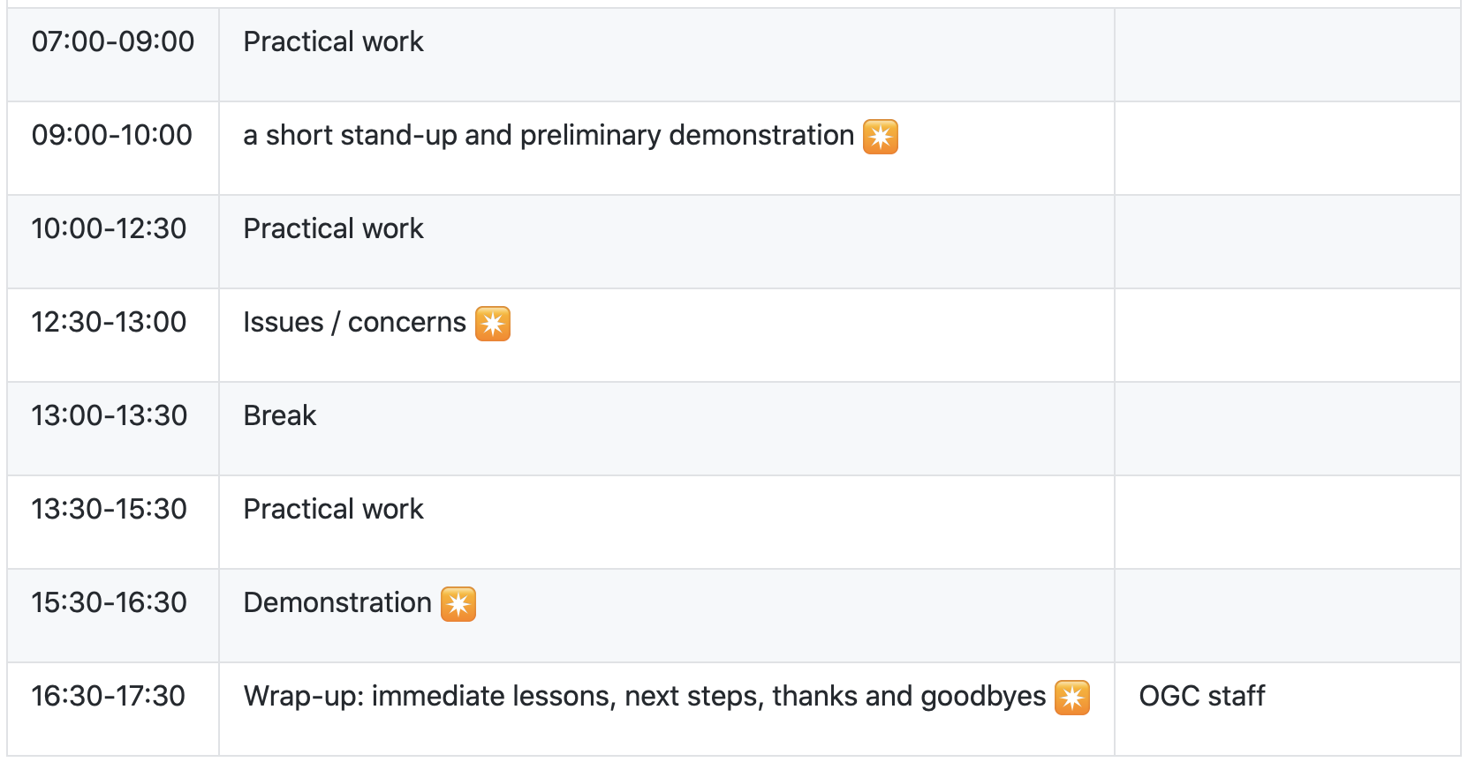
Sprint Schedule – Day 3 – July 23

Slide 14
Logistics
Gotomeeting
Link to be provided to registered participants only.
Gitter
https://gitter.im/ogc-developer/Sprints
GitHub
Sprint repo https://github.com/opengeospatial/ogcapi-code-sprint-2021-07

Slide 15
Community
500+ International Members
110+ Member Meetings
60+ Alliance and Liaison partners
50+ Standards Working Groups
45+ Domain Working Groups
25+ Years of Not for Profit Work 10+ Regional and Country Forums
Innovation
120+ Innovation Initiatives
380+ Technical reports
Quarterly Tech Trends monitoring
Standards
65+ Adopted Standards
300+ products with 1000+ certified implementations
1,700,000+ Operational Data Sets Using OGC Standards
Contact info@ogc.org to schedule a meeting for an in-depth discussion with OGC staff and join our community today!
Notes:
If you have any questions, do not hesitate to reach out to OGC or schedule a follow-up. We’re working constantly to change the landscape of location information and want to help your organization get where it needs to go.

